Slide 1
Intranet
Chekwoti Aramadhan
Islamic University in Uganda

Slide 2
Key concepts
Internet
Intranet
Extranet

Slide 3
What is an intranet?
An intranet is a private internal network that organizations use to facilitate secure communication, collaboration, and information sharing among employees.
It operates similarly to the internet but is restricted to authorized users within the organization.
An intranet is a private internal network that organizations use to facilitate secure communication, collaboration, and information sharing among employees.
It operates similarly to the internet but is restricted to authorized users within the organization.
An intranet is a corporate LAN and/or Wide Area Network (WAN) that is secured behind company’s firewalls and it uses Internet technologies
Intranets often include features such as document management systems, employee directories, and communication tools, enabling employees to access company resources efficiently and securely.

Slide 4
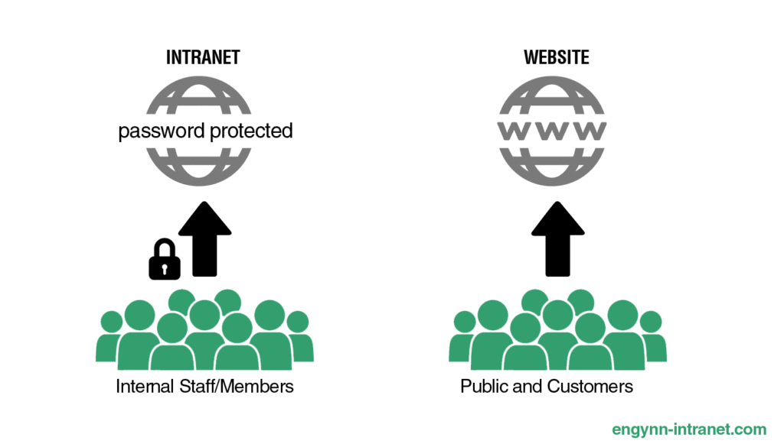
The Intranet

Slide 5
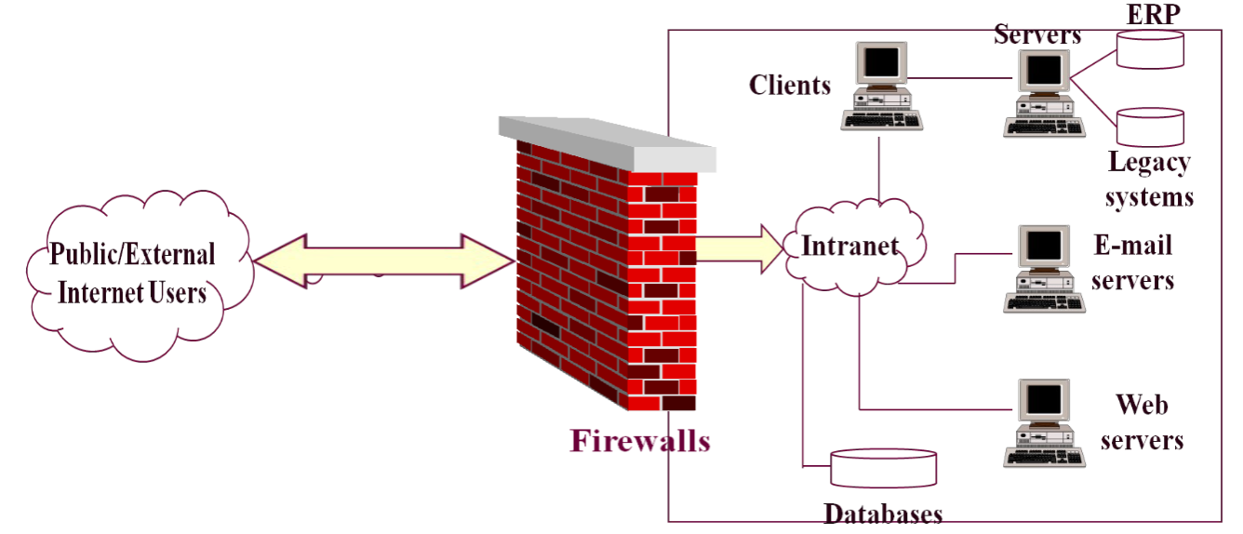
…

Slide 6
History of intranets
Before there was the internet, there was first an intranet.
It should come as no surprise that the first intranet was created by the Department of Defense Advanced Research Projects Agency.
The ARPANET linked the Department of Defense computers together, allowing for easier use and enhanced capabilities.

Slide 7
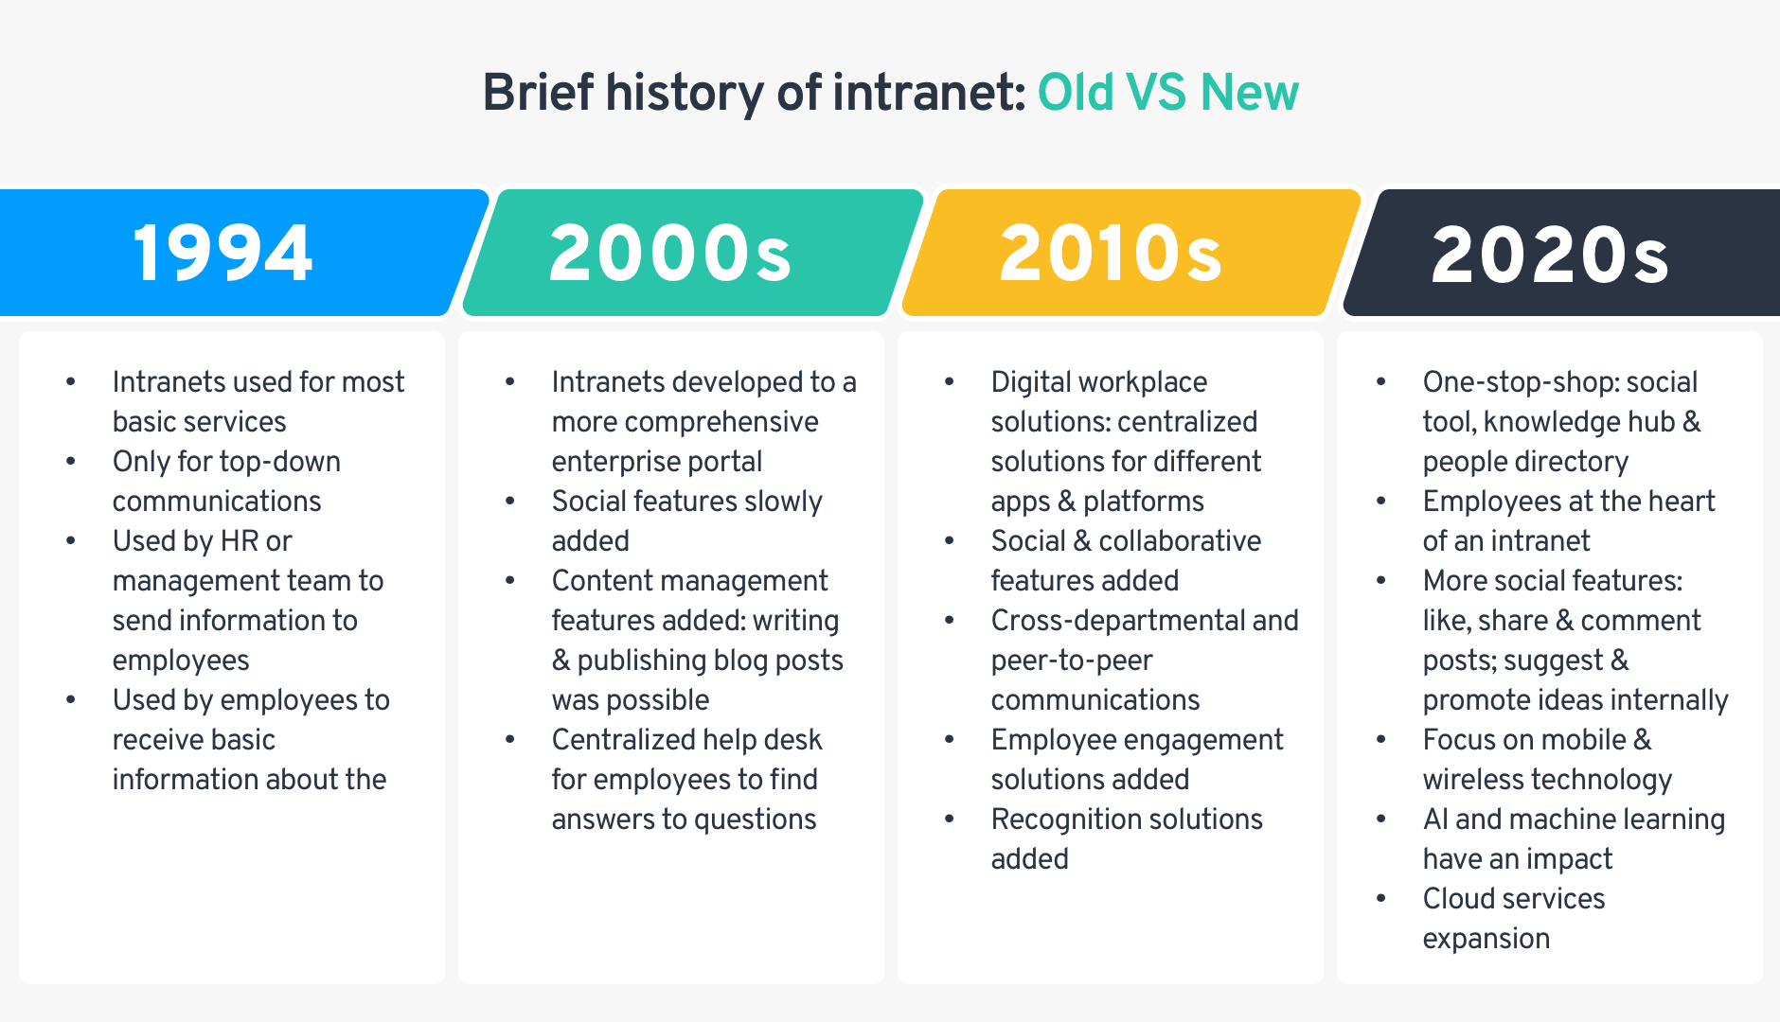
…

Slide 8
Benefits and Uses of Intranets to Organizations Benefits:
Enhanced Communication:
Intranets streamline internal communication by providing platforms for announcements, discussions, and feedback, which reduces reliance on emails and meetings.
Improved Collaboration:
They enable teamwork through shared documents, project management tools, and real-time communication channels, fostering a collaborative work environment.

Slide 9
…
Centralized Information Access:
Intranets serve as a single repository for important company information, policies, and updates, making it easy for employees to find what they need quickly.
Increased Productivity:
By providing easy access to resources and tools, intranets help employees perform tasks more efficiently, ultimately saving time and enhancing overall productivity.

Slide 10
…
Establishing and reinforcing a strong institutional culture
Enhanced Employee Engagement:
Intranets promote a sense of community and connection among employees by offering platforms for social interaction and recognition.

Slide 11
Uses/importance
Knowledge Sharing:
Intranets facilitate the organization of knowledge through wikis, forums, and document libraries, ensuring that employees stay informed.
Project Management:
They provide tools for tracking tasks, deadlines, and project progress, helping teams stay organized.

Slide 12
…
Simplified records management
Reduced dependency on other employees
Decision Support
Promotes Innovation
Corporate Culture Development:
Intranets can be used as platforms for fostering corporate culture by allowing employees to discuss key issues and share ideas.

Slide 13
Extranet
Extranets are network connections that use Internet technologies to interconnect the intranet of an organization with the intranets of a number of external stakeholders and shareholders
With an extranet, each organization moves particular information outside of its private intranet but makes the information accessible only to certain other organizations, which share the extranet.
The extranet maximizes the communication advantages of an intranet to those outside the organization
It also allows easy sharing of ideas, easy access to product information, pricing, company information and policies and can, therefore, be used to train and support value-added resellers and manufacturers 'representatives

Slide 14
Summary on the internet, intranets and extranets
Attached seperately

Slide 15
End of presentation

